Slide 1
Getting Things Done
David Allen

Slide 2


Stress of not getting things done

Slide 3
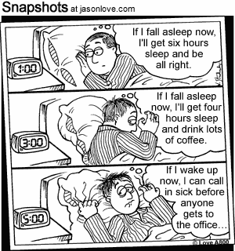
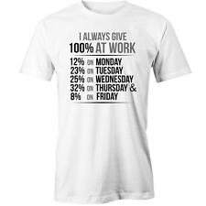
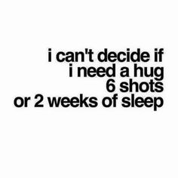
Consequence of working too much
After 6 months schedule

Slide 4
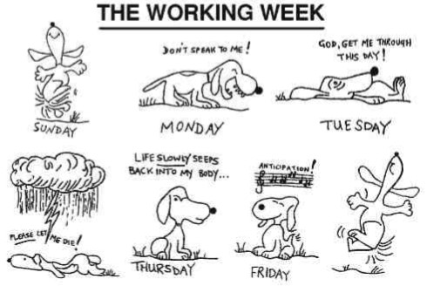
Losing control of my life

Slide 5
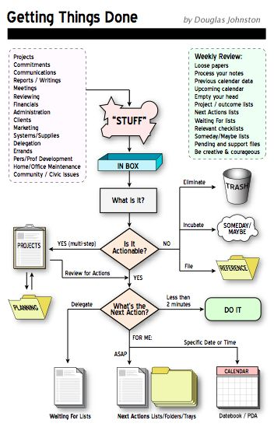
Is it Actionable – Most important feature in my data
Is it actionable
Yes
No

Slide 6
Mind Like Water - Clear
Get everything out on head into a basket/store
Get done with all two minute tasks
Emails can trigger unplanned actions – Avoid looking at them all the time
Have next actions associated with your do list
Try a ‘waiting for’ list
Plan your day (plans change but not if you don’t have one)
Automate (Any repetitive tasks – cooking, cleaning, laundry, choosing what to wear)
Build a habit
Not everything is important. Prioritize, what will make you most comfortable if you achieve one or two things today.
Lean thinking

Slide 7
Applications and further implications
I built habits implemented into my routine
Gym, same breakfast for two months, cooking once a week, saying no to friends on a week day, 90% consistent sleeping pattern
I feel better, think clearly
30-40 coffees a week, down to 2-7 coffees
Not grossed out by looking myself in the mirror
I have a to do list
More in control
Less stressed

Slide 8
Optimize but be careful
Do you have enough data
I will make the change and everything will be good.
It’s a complex algorithm. Which combination of hyperparameter will bring best results, will take time
Start with a 20% rule.
Your most valuable customers will generate 80% income
80% pipeline defects will be fixed by 20% of bug fixes

Slide 9

Power lies in action and experiment

Slide 10
